Slide 1


Real Estate Sales Data Analysis
DATA 606: Capstone Project in Data Science
Professor: Dr. Chaojie (Jay) Wang
Author: Sriharsha Nemalikonda

Slide 2

Project Background
The project aims to analyze real estate sales data in Connecticut from 2001 to 2020 to gain insights into the real estate market trends, property types, and sales prices over the years.
It can help in making informed decisions regarding property investments, policy adjustments, and market predictions.
Data sources - Office of Policy and Management [ https://portal.ct.gov/OPM/IGPP/Publications/Real-Estate-Sales-Listing ]
Data dictionary - Here each row in the dataset represents a single real estate sale transaction

Slide 3
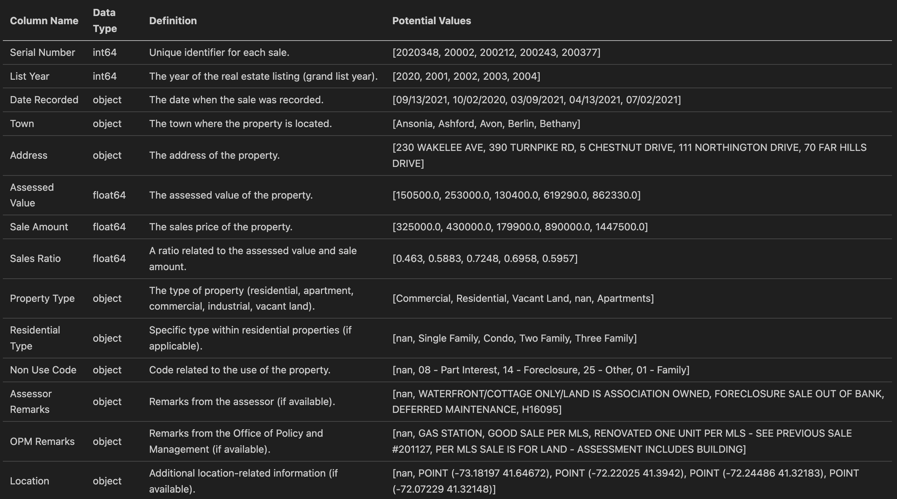
Data Dictionary

Slide 4
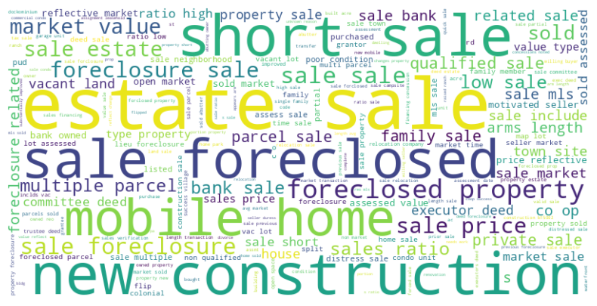
Word Cloud Visualization
Captures the most frequent terms in property remarks

Slide 5
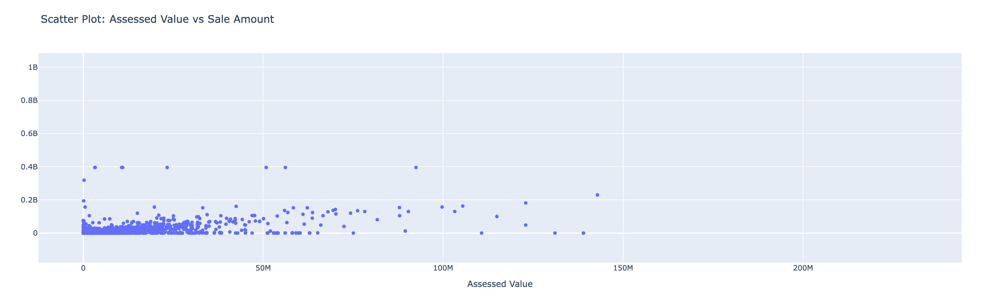
Assessed Value vs Sale Amount
The sale amount almost coincides with the assessed values less than 40M.

Slide 6
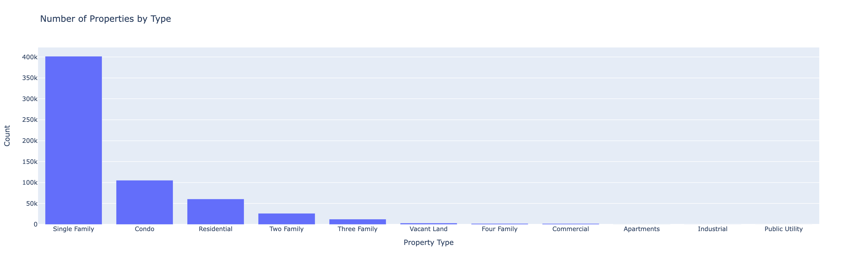
Number of Properties by Type
Most of the properties are owned by single family.

Slide 7
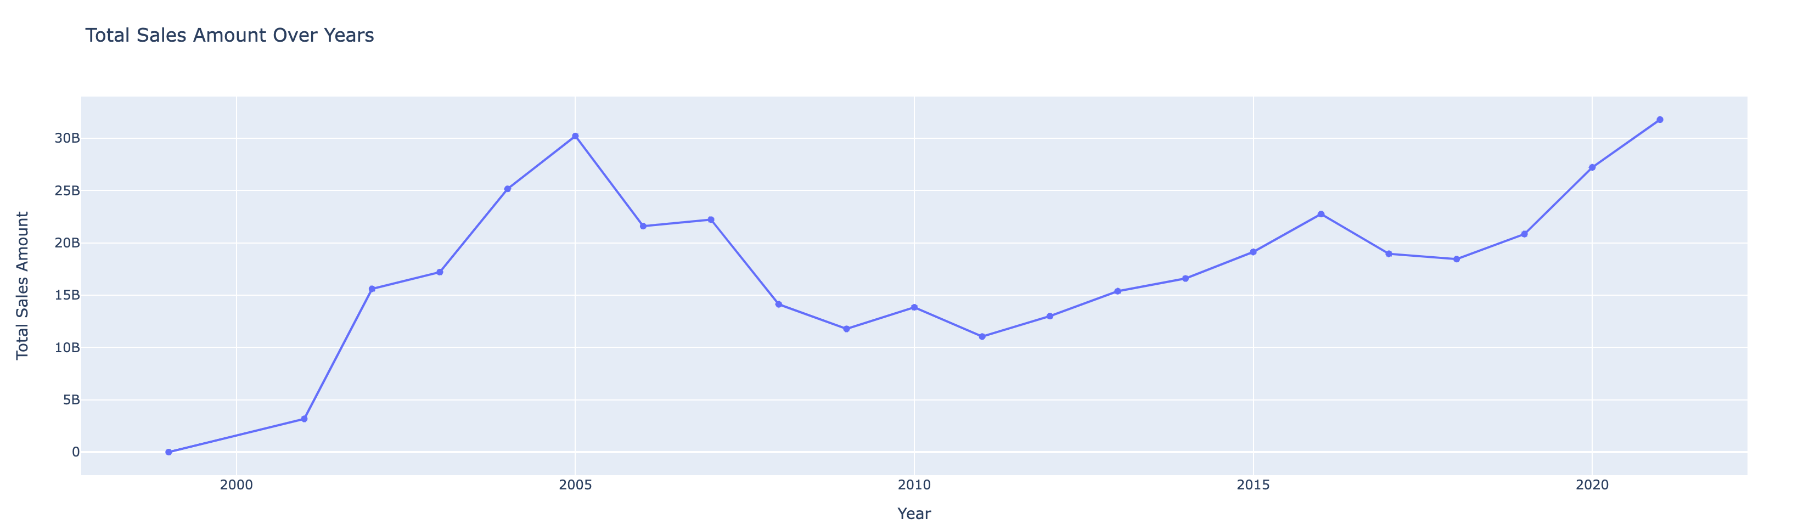
Total Sales Amount Over Years
There has been sudden dips in properties sold in the year 2006 & 2008.

Slide 8
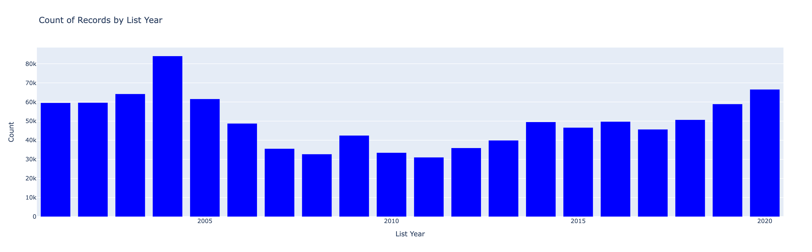
Bar Chart for List Year
2004 observed an increase in properties sold in the market.

Slide 9
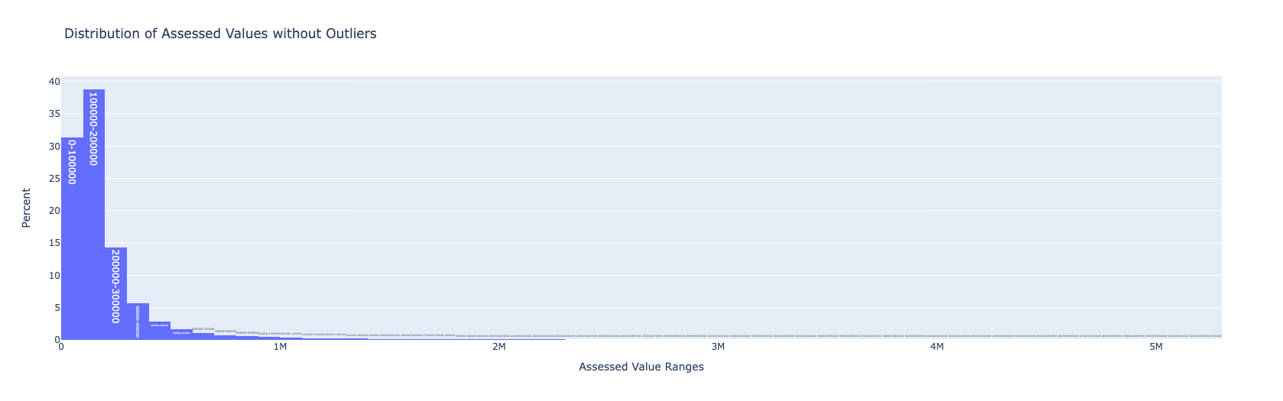
Distribution of Assessed Values
Higher the property assessed value lesser is that they are bought.

Slide 10
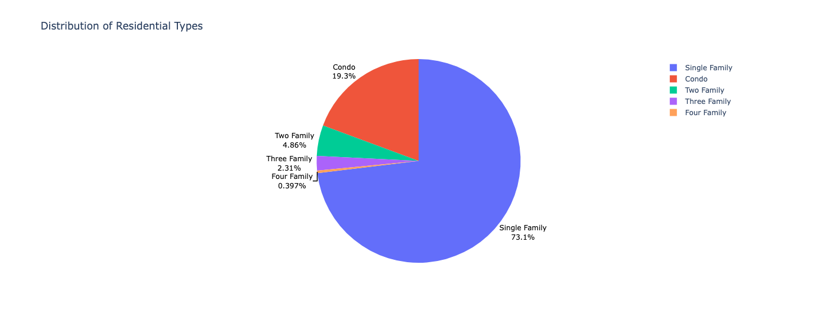
Distribution of Residential Types
Single families have a share of 73.1% properties.

Slide 11
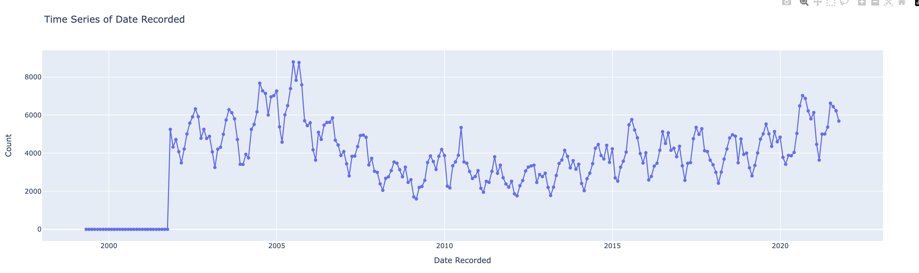
Time Series Plot for Date Recorded
There has been an exponential increase of the properties bought between Feb 2005 to Aug 2005, followed by a decline.

Slide 12
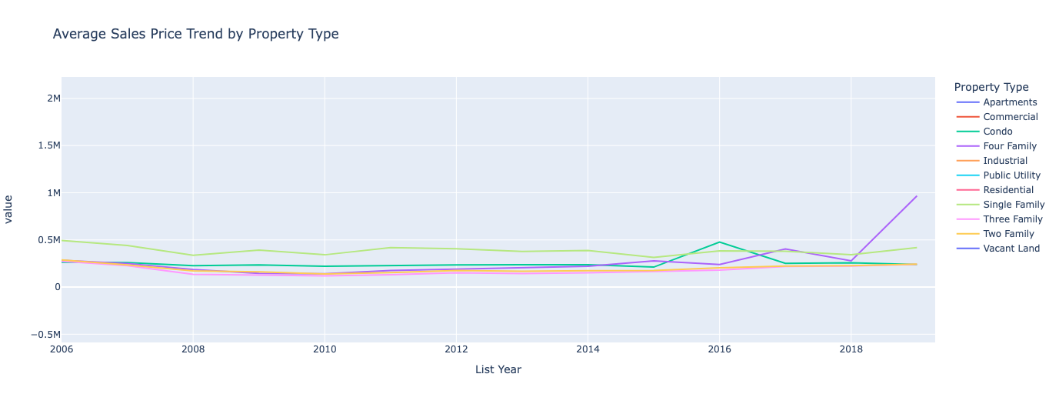
Trend in Average Sales Price by Property Type
There has been an increase in four family housing sale value after 2018.

Slide 13

Model Training & Selection
Data cleaning and preprocessing are essential to prepare the dataset.
Data is divided into training and testing sets for model evaluation.
The ML models implemented are:
Linear Regression
Ridge Regression
Gradient Boosting Regressor.
Features: 'List Year', 'Town', 'Assessed Value', 'Sales Ratio', 'Property Type', 'Residential Type’
Target: Sale Amount

Slide 14
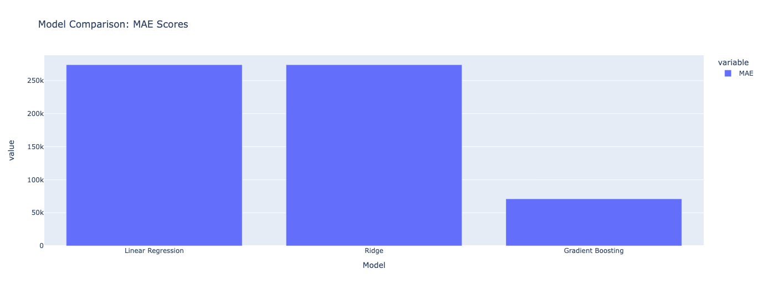
Model Performance Comparison
The Gradient Boosting model shows a significantly lower MAE, suggesting improved predictive accuracy.
Notes:
Linear Regression:
MAE: 273,972.77
R^2: 0.1303
Notes: This model has a relatively high MAE and a low R^2 score, indicating moderate predictive accuracy.
Ridge Regression:
MAE: 273,972.74
R^2: 0.1303
Notes: The Ridge Regression model provides similar results to Linear Regression, with a moderate MAE and R^2 score.
Gradient Boosting:
MAE: 70,958.89
R^2: -1.1019
Notes: The Gradient Boosting model shows a significantly lower MAE, suggesting improved predictive accuracy. However, the negative R^2 score may indicate issues such as overfitting.

Slide 15

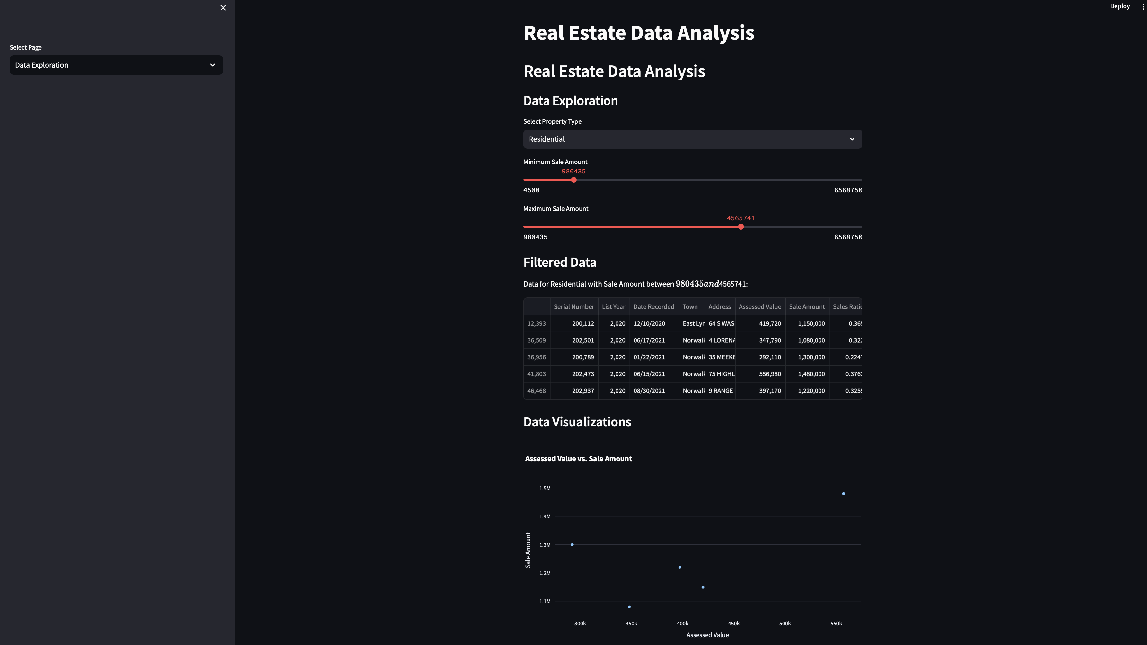
WebAPP : Data Exploration
We can explore the dataset by selecting ‘Sale Amount’ range and ‘Property Type’
Plot corresponding dynamics

Slide 16
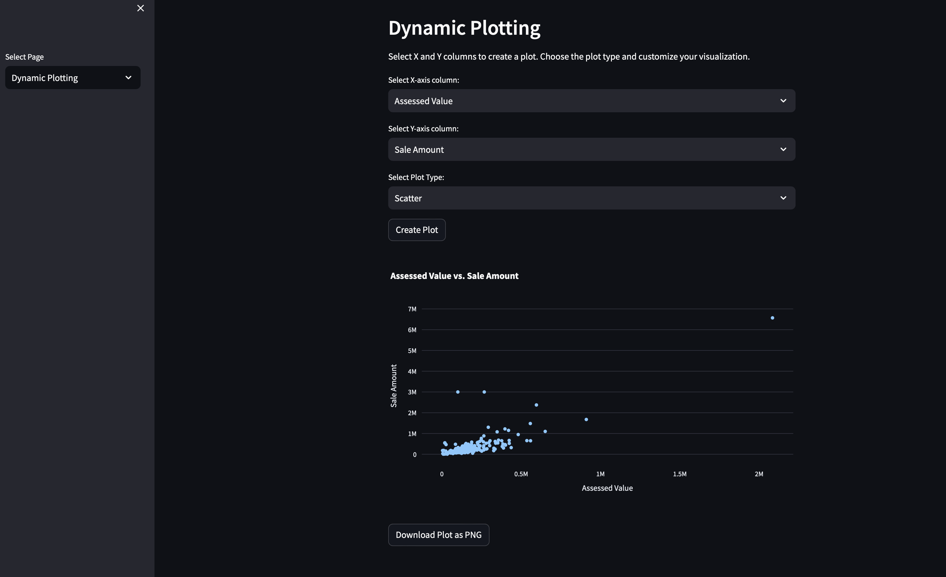
WebAPP : dynamic plotting
This page has the flexibility to plot dynamically by choosing the required column on the X & Y axis
Plot types like Scatter, Bar, Histogram, and line can be dynamically set.
The plot can be downloaded as PNG

Slide 17
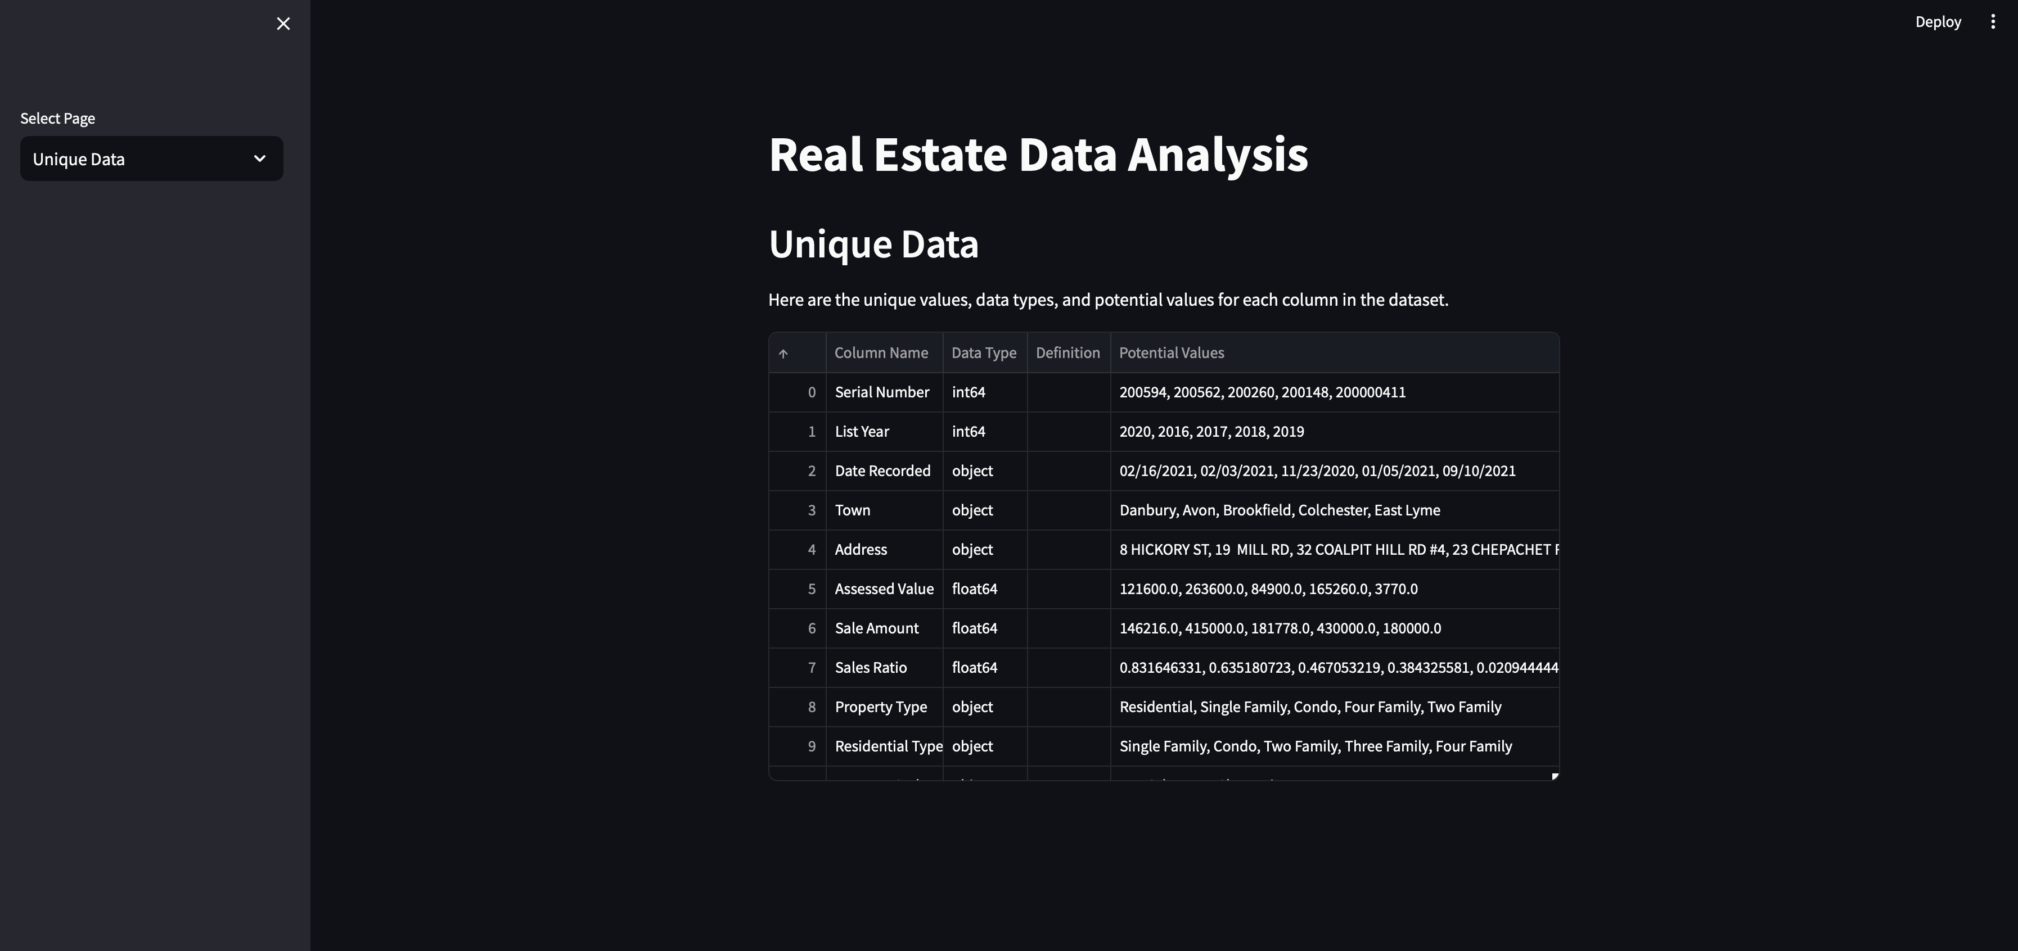
WebAPP : Unique data
Display the unique values in each column

Slide 18

Conclusion
There has been highest number of sales in 2004.
Most of the property values are in the range of 100K to 200K
Residential properties have a largest share with Single Family of 73% of all properties.
The sale value is more than the assessed value.
Gradient Boosting Regressor is the effective ML model.
Scope:
Predictive Modeling: Developing machine learning models for property price prediction or anomaly detection to identify potential investment opportunities.
Geospatial Analysis: Incorporating geospatial data to analyze property locations and their impact on prices.

Slide 19


Thank You

